Slide 1
Social Media App by Brian Barnabas Langay

Slide 2
Contents
Introduction
Networking
Database
Preview and Conclusion

Slide 3

Why Social Media ?

Slide 4
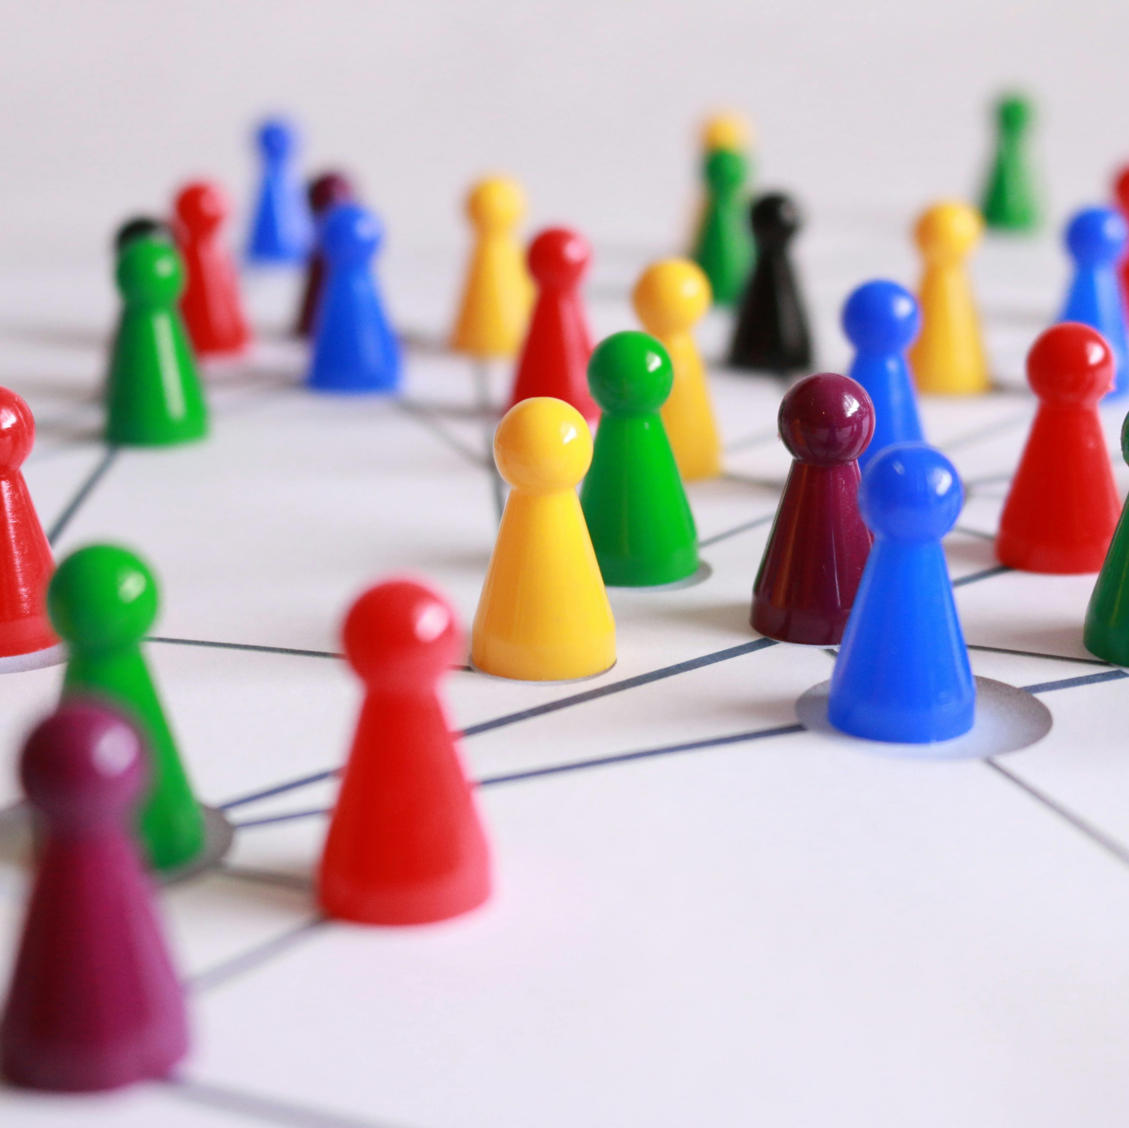
Introduction
Social media applications are mainly focus to help to bridge connection between people and help share data and interact upon different features developed to improve communication.
We have implemented a simple communication application that mimics the simple super social media application with interactive features.

Slide 5

What’s included (Features)
This is application will include.
Messaging
Wallet System
Weather
Movies (Data)
Feeds
Music
Games

Slide 6
Chat with Networking

Slide 7
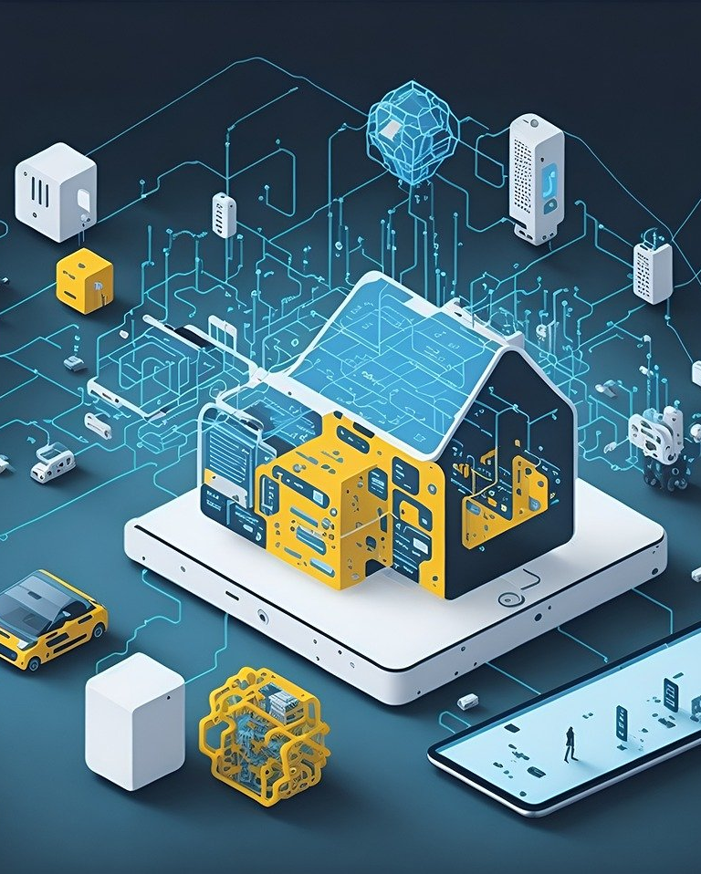
MQTT
MQTT (Message Queuing Telemetry Transport) is a lightweight messaging protocol designed for constrained devices and low-bandwidth, high-latency, or unreliable networks. It is commonly used for machine-to-machine (M2M) communication in the Internet of Things (IoT) and other scenarios where a small code footprint is required.
Client
Broker
Topic

Slide 8
MQTT Protocol
The MQTT protocol main components:
Client: The client is any device or application that connects to an MQTT broker to publish messages, subscribe to topics, or both. Clients can be publishers, subscribers, or both, depending on their role in the messaging system.
Broker: The broker is a server that acts as an intermediary between MQTT clients. It receives messages published by clients and routes them to the appropriate subscribers based on their subscriptions. The broker also manages client connections, authentication, and security policies. Multiple clients can connect to the same broker, enabling communication between devices or applications even if they are not directly connected to each other.
Topic: Topics are hierarchical identifiers used to categorize messages in the MQTT system. Publishers assign messages to specific topics when they publish them, and subscribers specify which topics they are interested in receiving messages from. Topics are represented as strings delimited by forward slashes ("/"), and they can have multiple levels of hierarchy (e.g., "sensors/temperature", "devices/+/status").

Slide 9

Social media App
The super social media app is developed with native Java Android application
Enhancement support from C and python.

Slide 10
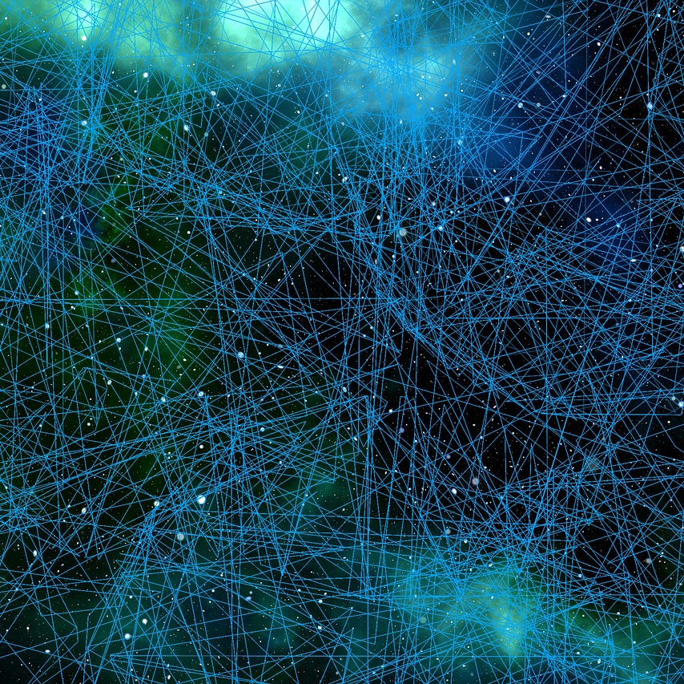
Chat system
I have implemented a chat system with different technologies and mainly with networking approach powered by MQTT technology

Slide 11
MQTT + Data (DB)
Data (DB) And MQTT:
User: This helps the Algorithm to operate dynamic system to operate its data extraction corresponding to the owner of device.
Friend (Friendliest): This helps to retrieve another key important object to our connection properties to enable connection between the two friends
Topic (Friendliest): lastly this is the most important component that will help us finalize the logic of publishing and retrieve data from given topic associated from this friends

Slide 12
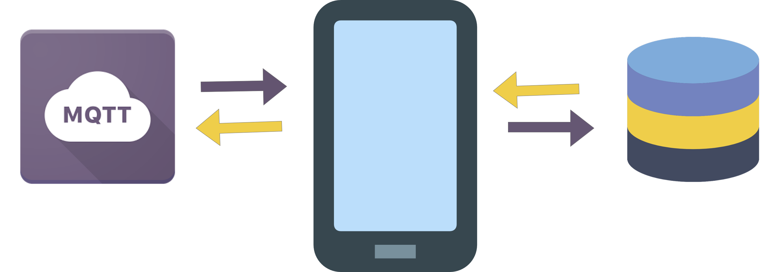
Network Architecture
The super social media app is powered by simple networking logic with for communication of one device to another user to user (U2U) connection and share data with android application
The MQTT is initialized to establish connections and user will be allocated to subscribe to different topics based on friends (user lists added) and local database used to catch the conversation shared between users in local device.
User Devices --> MQTT Broker (Hive MQ) --> Social Media Application Server --> Database

Slide 13
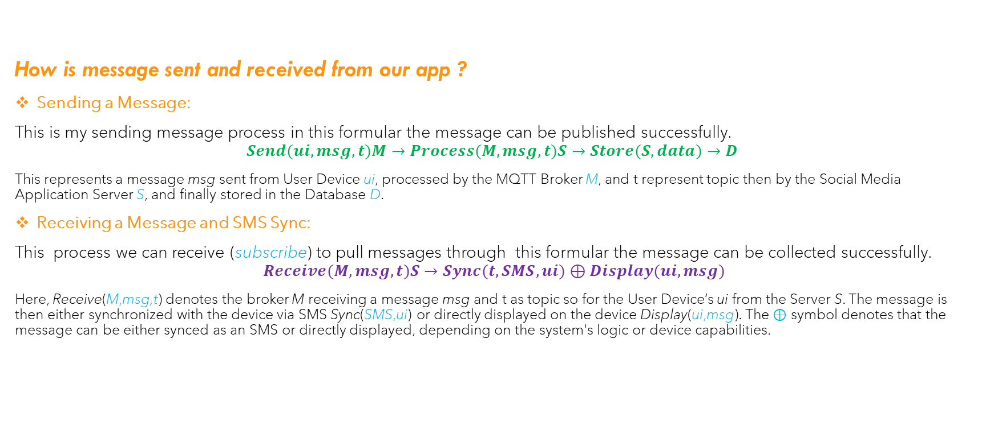
Data Distribution
How is message sent and received from our app ?
Sending a Message:
This is my sending message process in this formular the message can be published successfully.
$$Send(ui​,msg,t)M→​Process(M,msg,t)S​→Store(S,data)→D$$
This represents a message msg sent from User Device ui​, processed by the MQTT Broker M, and t represent topic then by the Social Media Application Server S, and finally stored in the Database D.
Receiving a Message and SMS Sync:
This process we can receive (subscribe) to pull messages through this formular the message can be collected successfully.
$$Receive(M,msg,t)S→​Sync(t,SMS,ui​)⊕Display(ui​,msg)$$
Here, Receive(M,msg,t) denotes the broker M receiving a message msg and t as topic so for the User Device’s ui​ from the Server S. The message is then either synchronized with the device via SMS Sync(SMS,ui​) or directly displayed on the device Display(ui​,msg). The ⊕ symbol denotes that the message can be either synced as an SMS or directly displayed, depending on the system's logic or device capabilities.

Slide 14
App preview

Slide 15
Comparison
Implementation | Measurement | Difficult | Cost
Custom Servers | High performance | High | Low
MQTT | High performance | High | Medium
DB | Medium performance | Medium | Medium
Third party | High performance | Low | High

Slide 16
Thank you
Brian Barnabas Langay
brianlangay0@gmail.com

